Slide 1
Business Analytics Case Study
Data Science Summit’21, Society for Data Science, BIT Mesra
Team Name – Data Geeks
Team Members –
1. Aman Mittal, IIT(ISM), Dhanbad
2. Indrani Sen, BIT, Mesra
3. Kajal Mahato, BIT, Mesra
4. Ananyapam De, IISER, Kolkata

Slide 2
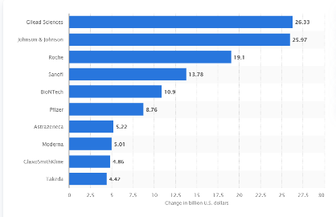
Worldwide Pharmaceutical Sector
The pharmaceutical industry is currently valued at $41 bn.
Indian pharmaceutical sector supplies over 50% of the global demand for various vaccines, 40% of the generic demand for US and 25% of all medicines for UK. India contributes the second largest share of pharmaceutical and biotech workforce in the world. India’s domestic pharmaceutical market turnover reached Rs. 1.4 lakh crore (US$ 20.03 billion) in 2019, up 9.8% y-o-y from Rs. 1.29 lakh crore (US$ 18.12 billion) in 2018. In May 2020, pharmaceutical sales grew 9% y-o-y to Rs. 10,342 crore (US$ 1.47 billion).

Slide 3
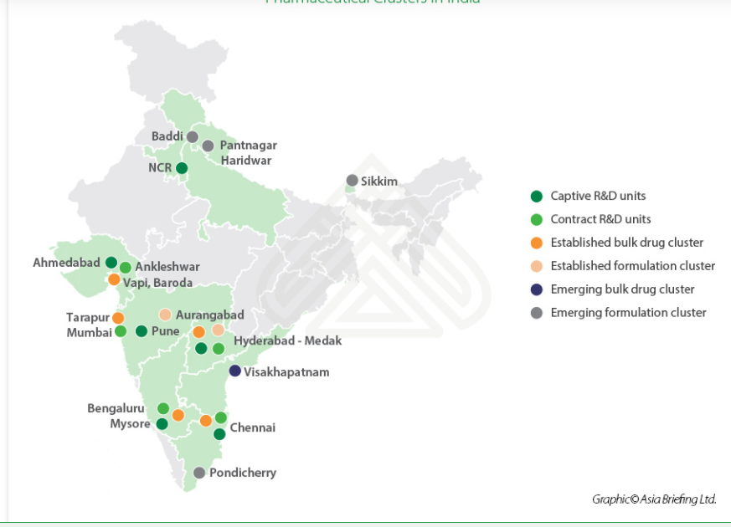
Pharmaceutical Demographic Clusters
The states which are developed and are emerging in pharmaceutical sector are → Gujarat, Maharashtra, Karnataka, Andhra Pradesh, Tamil Nadu and Telangana.

Slide 4
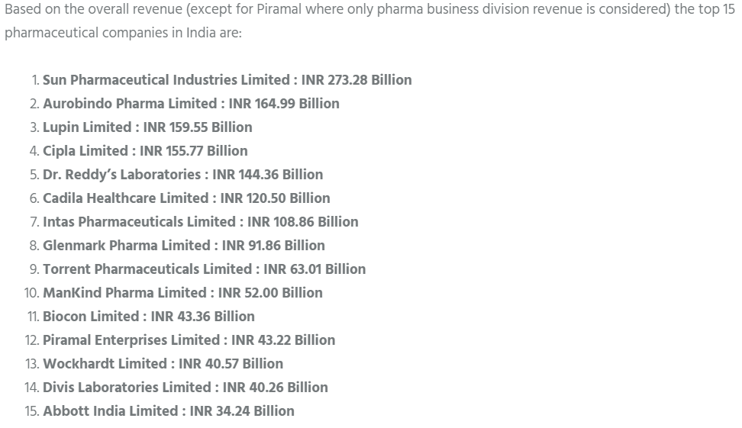
Top companies in the pharmaceutical sector
The price range of competitor’s vaccine is in the range of Rs. 800 – Rs. 3000 per person.

Slide 5
ChemX portfolio and goals in the market
ChemX is a new company which aims at gaining the covid19 vaccine market share.
The maximum revenue generated is a key target, as well as providing vaccine to as many people as possible.
ChemX would not want to tap into the markets where the revenue could fall short of cost of operations.
Foreign investment in this sector is NULL.
One person requires one dose for complete vaccination.
Goals:
Best opportunistic locations for ChemX
ChemX Vaccine distribution across top 5 states in the pharmaceutical market
Optimal pricing for the vaccine
Optimal marketing and finance plan

Slide 6
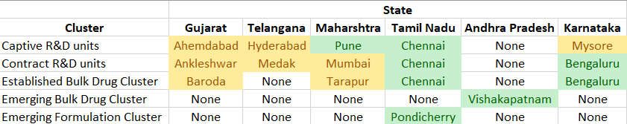
1. Opportunistic locations and reasons
The overall best locations for ChemX are Tamil Nadu, Karnataka and Andhra Pradesh.
As Vishakhapatnam, Andhra Pradesh is a costal area and an emerging bulk drug cluster, shipping facilities and prices of drugs used will be sufficiently low because of low competition. The formulation of the drug can take place in Pondicherry, Tamil Nadu because of the same reasons.
To create R&D units, ChemX can start at Chennai, Tamil Nadu due to availability of an established bulk drug cluster and captive R&D unit when the company wants to build an off-shore account. And it can expand to Bengaluru as it is the technological hub and the company can avail many amenities and facilities. This will give ChemX time to settle in the market according to the customer demographic and continue its operations at low expenditure as compared to companies in Gujarat where the competition is high.

Slide 7
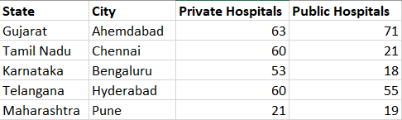
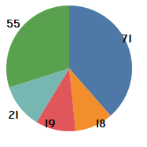
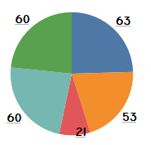
2. Vaccine Distribution
The top 5 states for vaccine distribution are : Gujarat, Karnataka, Maharashtra, Telangana, Tamil Nadu
The order for vaccine distribution will be as such – Gujarat, Tamil Nadu, Karnataka, Maharashtra, Telangana
Vaccine% in public hospitals
Vaccine% in private hospitals

Slide 8
3 and 4. Optimum Pricing, Marketing and Finance plan
Pricing should be such that state-wise/city-wise, the total revenue generated must be so that the company doesn’t face operational and marketing loss. As the vaccine cost of the competitor’s are between INR 800 – INR 3000.
In the states of Gujarat and Maharashtra where the competition is high, the prices will be kept near the lower margin – INR 900 – INR 1000 so as to attract customer to ChemX vaccine drug.
In the states of Andhra Pradesh, Telangana and Karnataka, , we can cost the drug in the middle – high range (INR 1200 – INR 1800) as the number of private and public hospitals are comparatively low.
In the state of Tamil Nadu, we can charge the vaccine as INR 2000 – INR 2500;
till we reach the level of the current competition in other states and gradually, we can increase the price, increase operation, increase marketability procedures with decreased cost with sector expansion starting in the southern region.
Depending on the distributing distance, we can add road tax and transport cost to the operation and thus manage advertisement and transport cost accordingly.

Slide 9
Thank you, Team Data Geeks

